Slide 1
Fabric Options for Dynamics 365 Business Central
Integrating ERP solutions for business intelligence.
Notes:
AI-generated content may be incorrect. --- This presentation explores how to leverage Microsoft Fabric to meet data warehousing needs, with a focus on integration with Microsoft Dynamics 365 Business Central. Attendees will learn about architecture, best practices, and tools to enhance data management and business intelligence capabilities.

Slide 2
Agenda
Introductions
Who am I and who I work for
Introduction to Microsoft Fabric
This section will introduce Microsoft Fabric, its purpose, and relevance in data management. Some my already know this content, but for those who are new to Fabric, this section will help you to gain an understand of the components we will be discussing in the rest of the presentation.
Key Benefits of Fabric
We'll explore the benefits of leveraging Fabric for your data warehousing needs.
Benefits for Data Warehousing
Discussing how Microsoft Fabric enhances data warehousing capabilities and efficiency.
Integration Technologies
Examining integration technologies for Dynamics 365 Business Central within Fabric.
Best Practices for Data Handling
Highlighting best practices for data extraction and transformation processes.
Notes:
In this session, we will cover several key topics: Introduction to Microsoft Fabric, components overview, benefits for data warehousing, integration technologies for Dynamics 365 Business Central, best practices for data extraction and transformation, and strategies for optimizing data storage and performance.

Slide 3


Chris Hetzler
Experienced Solution Architect and Senior Manager.
Over 17 years of experience with Microsoft.
Expertise in Dynamics, Fabric, Power Platform, and Azure.
Master degrees in Software Engineering and Data Science.
Active contributor to industry knowledge through blogging and social media.
20+ Microsoft certifications, including Fabric Analyst and Fabric Engineer (DP-600 & DP-700) and Dynamics 365 Business Central Developer (MB-820)
LinkedIn - https://www.linkedin.com/in/thehetz/
Blog – https://www.thehetz.com/blog
Edie Bailly – https://www.eidebailly.com/microsoft
Notes:
This slide provides an overview of my professional background and expertise. With years of experience at Microsoft and a solid educational foundation, I've specialized in data management and cloud solutions. I actively share insights through my blog and social media, aiming to foster knowledge in the industry.

Slide 4

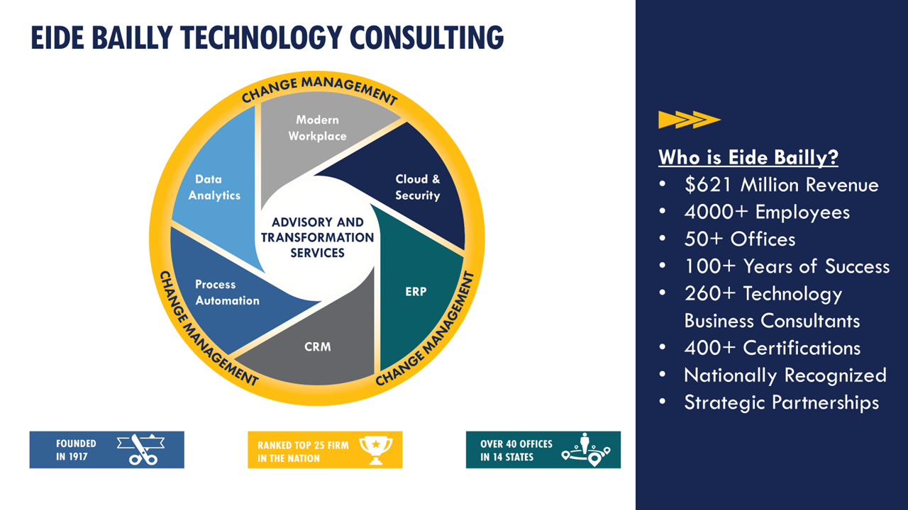

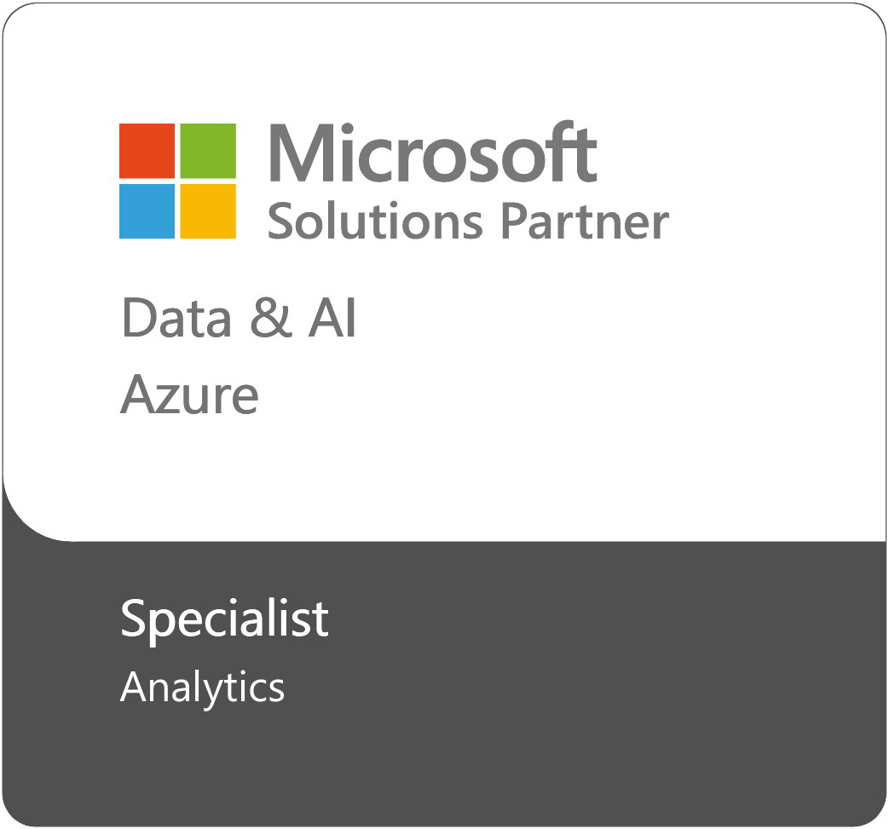
Eide Bailly, LLP
Contact us: Business Intelligence Viability: 2-Hr Assessment – Microsoft AppSource

Slide 5
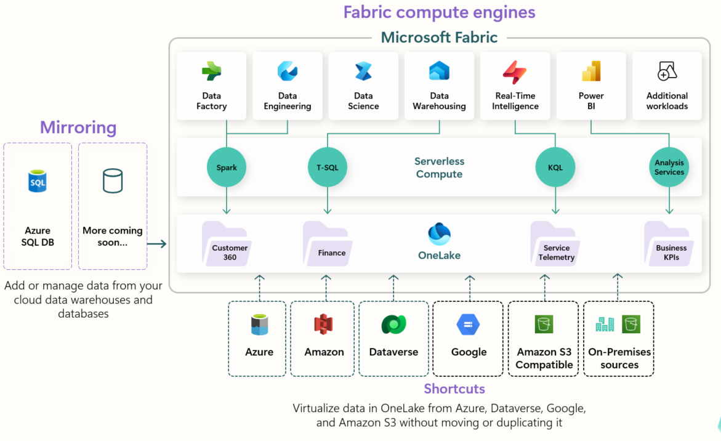
Introduction to Microsoft Fabric
Comprehensive Data Management
Microsoft Fabric provides a complete solution for managing data across various platforms. This ensures higher efficiency and control over data assets.
Enhanced Analytical Capabilities
The platform enhances analytical capabilities, allowing businesses to derive insights effectively. This empowers informed decision-making across the organization.
Streamlined Operations
With robust data warehouses, operations become streamlined, leading to improved productivity. This results in faster data processing and accessibility.
Notes:
Microsoft Fabric is a comprehensive platform designed for data integration and management. It allows users to create robust data warehouses that streamline operations and enhance analytical capabilities. This introduction will set the stage for deeper exploration into its components and benefits.

Slide 6
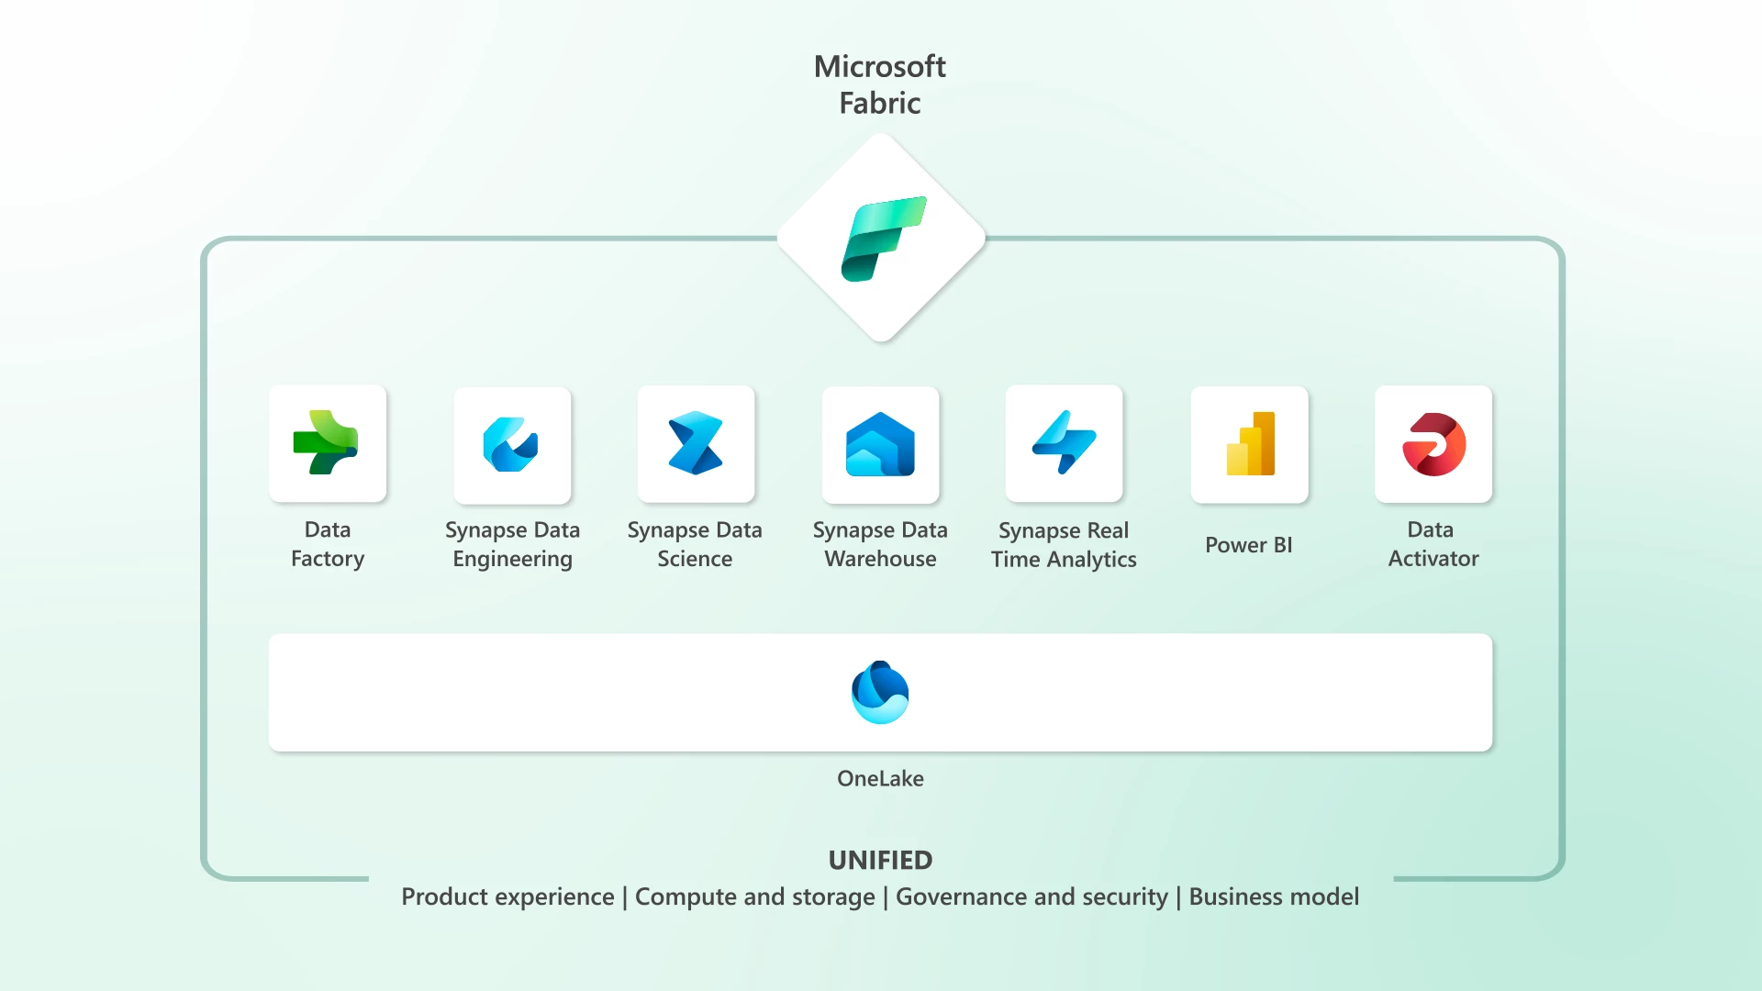
Key Benefits of Microsoft Fabric
Simplified Data Integration
Microsoft Fabric streamlines the integration process from various data sources, making it efficient and user-friendly. In this case, data from Business Central.
Enhanced Data Quality
It improves data accuracy and reliability, ensuring that businesses can make informed decisions. Better monitoring is possible through streamlined and simplified mechanisms.
Power BI Support
Microsoft Fabric provides tools for advanced analytics, empowering organizations to uncover valuable insights.
Fostering Collaboration
It encourages teamwork among data professionals, enhancing productivity and innovation.
Notes:
Using Microsoft Fabric for data warehousing provides numerous benefits: it simplifies data integration from multiple sources, enhances data quality, supports advanced analytics, and fosters better collaboration among data professionals. These advantages collectively boost business intelligence initiatives.

Slide 7
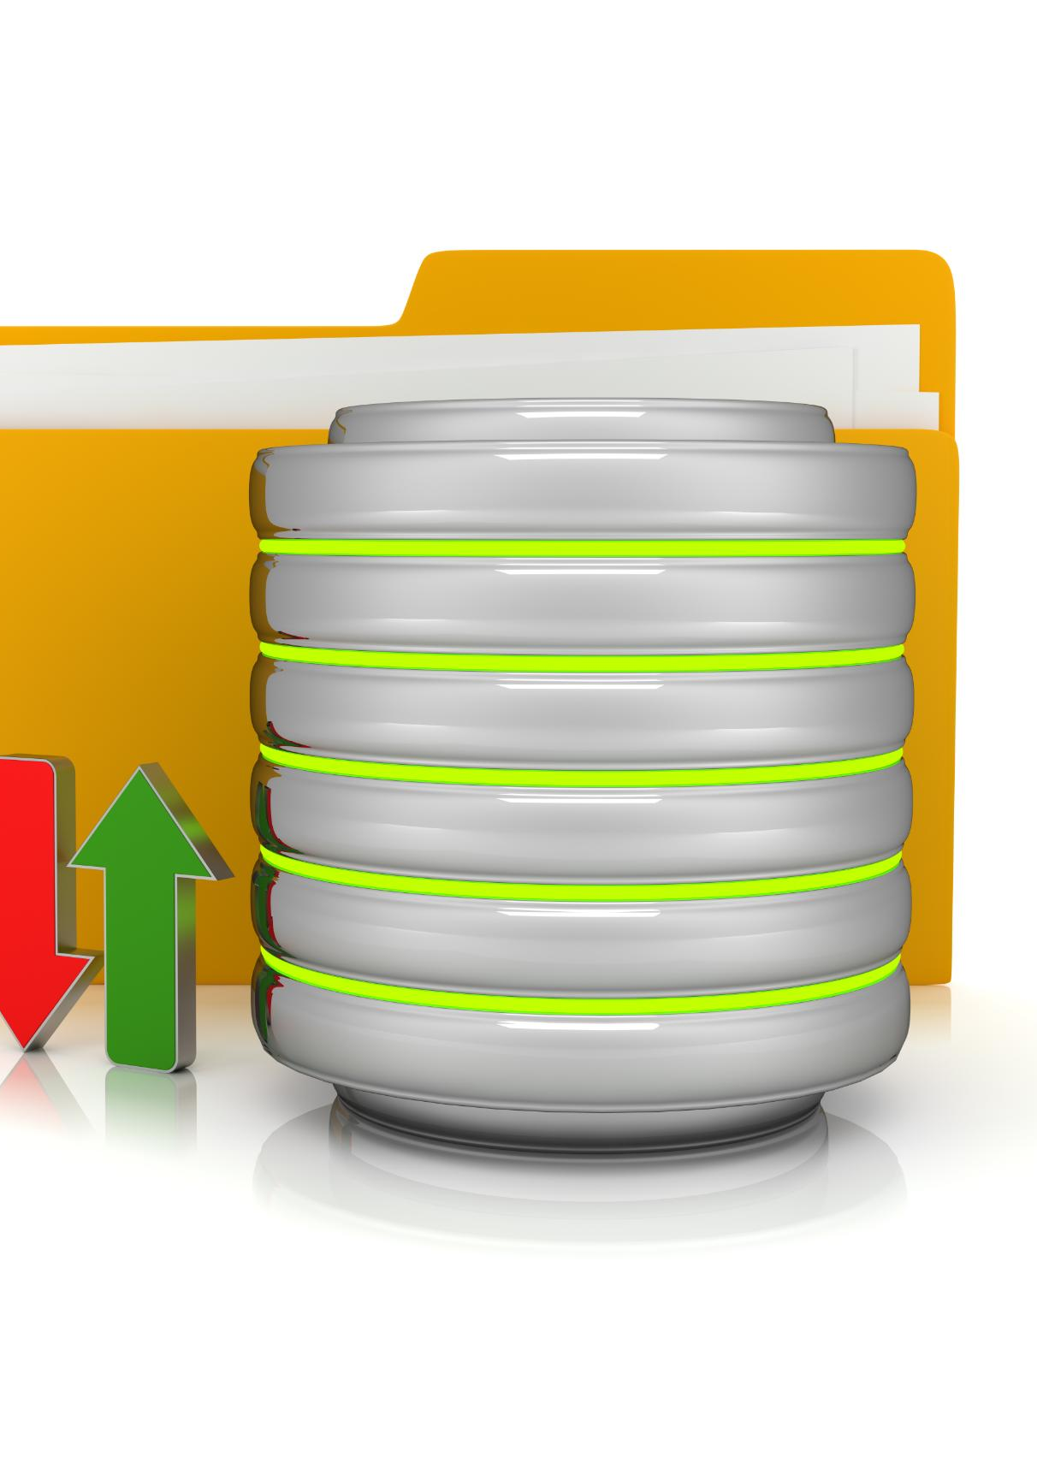
Data Warehousing
Real-World Effectiveness
Microsoft Fabric has proven effective in real-world data warehousing scenarios. Organizations have seen tangible improvements in their data management. They have also realized operational efficiencies through more effective collaboration.
Successful Implementations
Various organizations successfully implemented Microsoft Fabric to enhance their data operations. We will cover a Microsoft case study, as well as a case study from Eide Bailly. Eide Bailly now has 18 clients live on Fabric data warehouses. Medallion architectures are proving to be game changing for our clients.
Business Success
The adoption of Microsoft Fabric has led to improved business outcomes. Enhanced data practices drive overall organizational success. The efficiencies that Eide Bailly’s clients have realized will be summarized during our case study overview.
Notes:
Real-world examples illustrate the effectiveness of Microsoft Fabric in data warehousing. These case studies highlight how organizations have successfully implemented Microsoft Fabric to improve their data management practices and drive business success.

Slide 8

Real-World Example from Microsoft:
Executive Summary
Australian rail freight operator Aurizon wanted to modernize its data warehouse to improve cost efficiency and scalability and enable predictive maintenance. Joining the Microsoft Fabric preview program and taking advantage of its data streaming functionality and AI and machine learning capabilities is helping it achieve these goals.
Data Warehousing
A significant percentage of Aurizon’s cost base is associated with buying and maintaining assets. Using data and analytics to increase efficiency around maintenance is a critical element of its cost-saving strategy. The company’s data also presents many opportunities for optimization around crew rostering, yard management, scheduling, and daily operations.
Predictive Maintenance
Microsoft Fabric can achieve this by providing Aurizon with a unified product that integrates every aspect of its data estate via an open software as a service (SaaS) analytics and AI platform. The Power BI integration in Microsoft Fabric helps ensure datasets no longer need to be imported and can instead be accessed using Direct Lake in Power BI. In short, they are loaded from a data lake straight into the Power BI engine—ready for analysis.
Notes:
Company A utilized Microsoft Fabric to integrate its data from multiple business units. By doing so, it significantly improved its reporting capabilities and data-driven decision-making processes, showcasing the power of a streamlined data warehousing solution.

Slide 9

Eide Bailly Case Study:
Challenge Faced
Mi-Pod was struggling with a data warehouse which they did not understand, build in a technology which they did not understand (Azure Synapse). Proprietary vendor implementation of ADLS and Synapse for Business Central ETL processes.
Adoption of Microsoft Fabric
The company implemented Microsoft Fabric to centralize their data engineers and their data analysts. They have also reduced maintenance costs and downtime.
Unified View
With Microsoft Fabric, Mi-Pod gained a comprehensive view of their data, ETL processes, and reports. Staff have a “single pane of glass” to look through when it comes to their data estate.
Notes:
Company B faced challenges with data silos and inefficient reporting. By adopting Microsoft Fabric, they achieved a unified view of data, which enhanced their operational efficiency and resulted in better strategic insights.

Slide 10

Business Central Integration Options
BC2ADLS
Includes all the components needed to get up and running with a Fabric OR Azure Data Lake / Synapse integration. Included are a Business Central App and Fabric notebook. Leverages Lakehouse storage in Fabric for files and tables. Differential loads and custom fields supported.
Dataverse Shortcut
Business Central includes an integration with Microsoft Dataverse. This can be enabled and Dataverse can be shortcut to within Fabric. Not as user friendly or as straight forward as BC2ADLS, but it is built into BC and simple.
Business Central Web APIs
Unless custom APIs are developed these are quite limited in the data they will supply. These could be an option for very simple reporting requirements, however.
Notes:
Integrating data from Microsoft Dynamics 365 Business Central into Microsoft Fabric involves several technologies. This overview will discuss the various integration tools available, including Dataflows, Power Query, and Azure Data Factory.

Slide 11
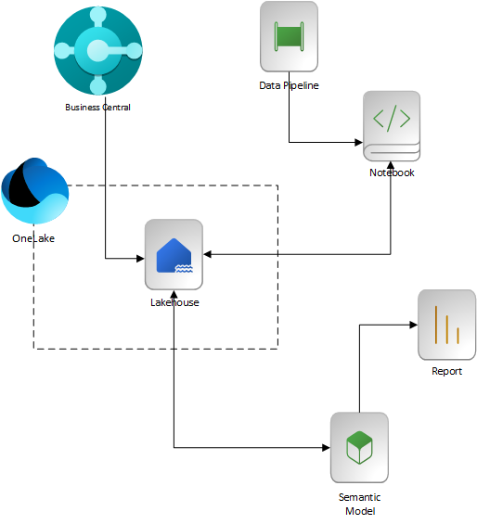
Integration Technologies: BC2ADLS
Components within Microsoft Fabric
Microsoft Fabric Pipelines, Notebooks, Lakehouse, Semantic Model, and Power BI reports are all parts of this solution.
Role of Pipelines
Pipelines allow for the transformation and loading of data efficiently. They are essential for ETL operations. The pipeline in our solution schedules the notebook and semantic model refresh.
Importance of Notebooks
Notebook simplifies data preparation and transformation. It streamlines the data integration process and enables fine-grained control over the transformation process when moving from file to table storage within the Lakehouse.
BC2ADLS Project: https://github.com/Bertverbeek4PS/bc2adls
Notes:
The Microsoft Fabric architecture consists of various components, including Dataflows, Power Query, and Azure Data Factory. Each plays a crucial role in facilitating data integration and management, ensuring that users can build an efficient data warehousing environment.

Slide 12
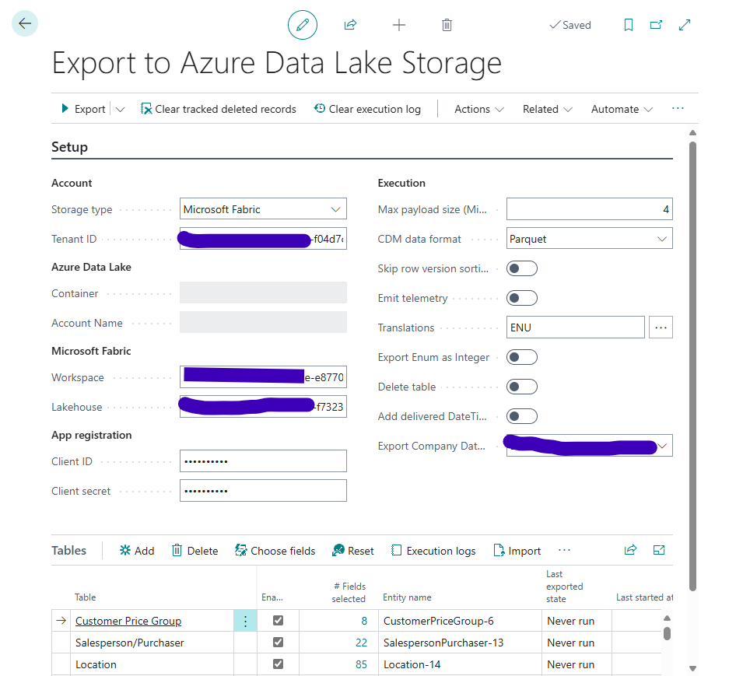
Integration Technologies: BC2ADLS
Easy to Configure
The BC2ADLS App installs from AppSource. You do need to configure an Entra Application for the authentication. Always supply the GUIDs for the tenant, workspace, and Lakehouse ids.
Intuitive Interface
Follows the normal design patterns for BC pages and forms. Allows for streamlined configuration, maintenance, and customization.
Data Extraction from Dynamics 365 Business Central
Data replication into the Fabric Lakehouse is scheduled via the Business central Job Queue. After the initial data load, only the deltas are replicated into Fabric Lakehouse file storage.
Notes:
Power Query is a powerful tool for data transformation and preparation. It provides an intuitive interface for extracting data from Dynamics 365 and performing necessary transformations before loading it into Microsoft Fabric.

Slide 13
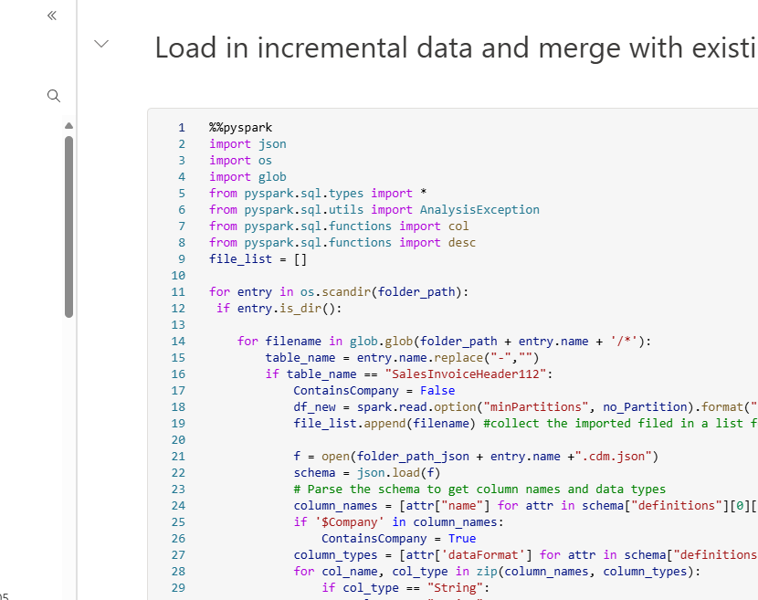
Integration Technologies: BC2ADLS
Pyspark Notebook
Transforms the data extracts and moves it from Lakehouse files, into Lakehouse tables.
Semantic Model
Uses the tables from the Lakehouse to model the relationships within the data and present that modeled data to Power BI for reporting.
Notes:
The Microsoft Fabric architecture consists of various components, including Dataflows, Power Query, and Azure Data Factory. Each plays a crucial role in facilitating data integration and management, ensuring that users can build an efficient data warehousing environment.

Slide 14
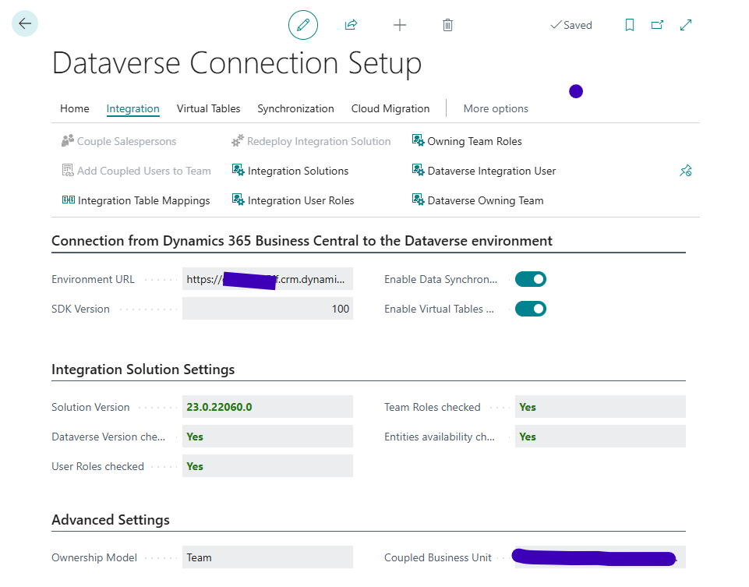
Integration Technologies: Dataverse
Native integration within Business Central
Configured with assisted setup and is the base integration for the Dynamics 365 Sales integration.
Shortcut within Fabric Lakehouse to Dataverse
A shortcut within the Lakehouse makes a data source appear as if it was in the Lakehouse itself, however the data is never copied from the source system.
Base or Reference objects only
Entities such as Vendor, Customer, Payment Terms, Shipping methods, etc. are supported out of the box. Others may be added but the process is a bit cumbersome and takes some time getting used to.
Notes:
The Microsoft Fabric architecture consists of various components, including Dataflows, Power Query, and Azure Data Factory. Each plays a crucial role in facilitating data integration and management, ensuring that users can build an efficient data warehousing environment.

Slide 15
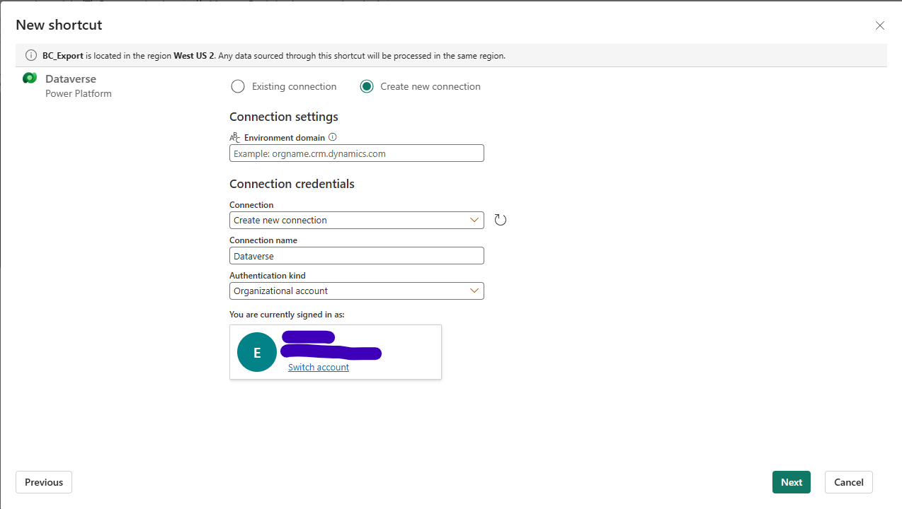
Integration Technologies: Dataverse
Fabric Shortcut
Easily created within the Lakehouse. Select Get data -> Shortcut.
Dataverse Link
The Dataverse first needs to be configured with a link to Fabric from the Analyze area within the Environment’s Admin portal.
Security
Since Fabric and Dataverse are tied to the same Entra Tenant, the surety within Dataverse will be honored by Fabric when users query the Dataverse data exposed via the shortcut.
Notes:
The Microsoft Fabric architecture consists of various components, including Dataflows, Power Query, and Azure Data Factory. Each plays a crucial role in facilitating data integration and management, ensuring that users can build an efficient data warehousing environment.

Slide 16
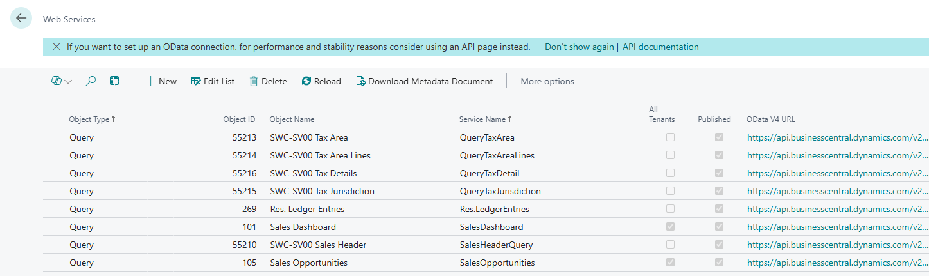
Integration Technologies: Web API
Fabric Pipeline
An Azure Function App needs to be created for calling into the Business Central Web APIs. Then a Fabric Pipeline can leverage this function to interact with the BC APIs in near real-time.
Lakehouse
The Pipeline can write the data retrieved from the function to either files or tables within the Lakehouse. Once tables are populated, a semantic model can be created / refreshed.
Security
Since the Azure function will be calling into Business Central Web APIs, an Entra Application is needed. This “service account” will be the calling user, so permissions are not guaranteed to be honored and only the Fabric Workspace security will be honored.
Notes:
The Microsoft Fabric architecture consists of various components, including Dataflows, Power Query, and Azure Data Factory. Each plays a crucial role in facilitating data integration and management, ensuring that users can build an efficient data warehousing environment.

Slide 17

Simple Data Extraction Workflow
Introduction to Data Extraction
Extract from Business Central using BC2ADLS, Dataverse, or Web APIs. Transform using a Fabric Notebook or Pipeline. Land the data in a Fabric Lakehouse using a pipeline. Refresh the semantic model using the pipeline or a scheduled refresh of the model.
Utilizing Microsoft Fabric Tools
Pipelines and Notebooks are the main transformation tools in play with a Business Central integration. Data is staged within the Lakehouse using files and / or tables.
Considerations for Streamlining
Leveraging the out-of-the-box functionality of the tools can ease the learning curve and reduce maintenance costs long term. Adding additional functionality within the transformations steps can lead to issues with maintenance, since those maintaining the solution will need this functionality documented.
Notes:
This demonstration will provide a sample data extraction workflow from Dynamics 365 Business Central using Microsoft Fabric tools. It will highlight key steps and considerations to streamline the process.

Slide 18

Performance Tuning in Fabric
Importance of Performance Tuning
Performance tuning maximizes the capabilities of Microsoft Fabric. It is crucial for effective data management.
Optimization Techniques Overview
If you are implementing a Medallion Architecture, stage your data in the Bronze layer Lakehouse before moving to the Silver or Gold Warehouse within Fabric.
Scheduling Strategies
All the techniques and tools discussed require scheduling of the data extraction. Ensuring that the schedules do not overlap and do not overload the systems curing peak business hours is critical to success.
Monitoring Mechanisms
Microsoft provides a Fabric Capacity monitoring app for use within your environment. I strongly encourage its use to ensure you understand which services (Notebooks, Pipelines, etc.) are consuming your capacity and when.
Notes:
Performance tuning is essential for maximizing the capabilities of Microsoft Fabric. This slide will cover optimization techniques, including indexing strategies and caching mechanisms to enhance query performance.

Slide 19
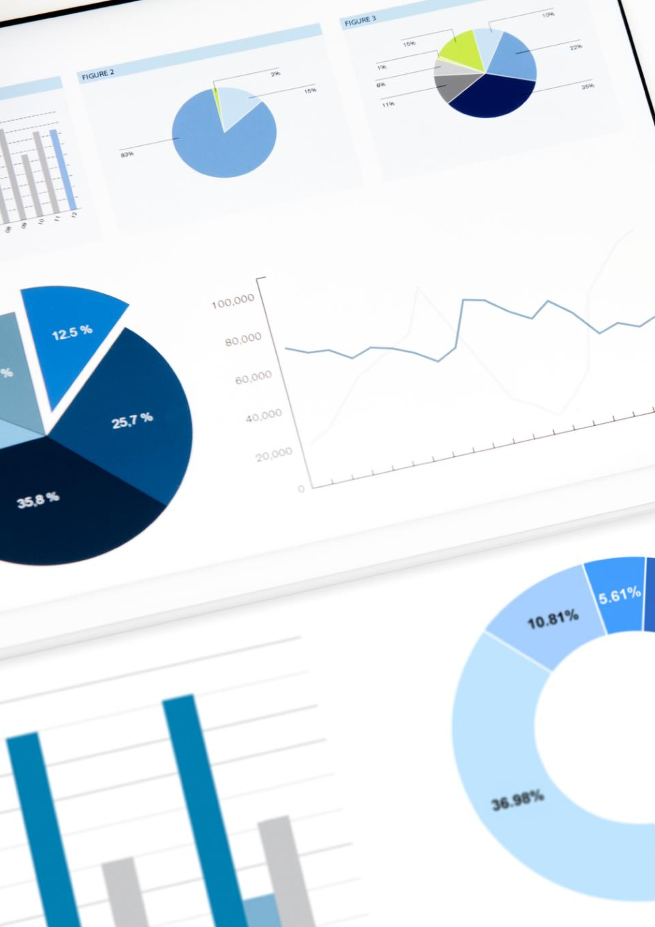
Using Reporting Tools in Microsoft Fabric
Integration with Reporting Tools
Microsoft Fabric seamlessly integrates with multiple reporting tools to boost efficiency. This integration supports diverse data sources and formats. Power BI is the default tool; however, Tableau can be leveraged as well via the Lakehouse SQL endpoint.
Drill-Through in Data Visualizations
When leveraging Power BI, analysts and dashboard users can drilldown into the underlying Business Central data. This allows for deep understanding of any areas within the data of concern.
Copilot within Fabric
Copilot is now available to users on any paid capacity within Fabric. Until recently, this was only available to users on an F64 capacity. Copilot will assist with building reports, building notebooks, and creating SQL queries within Data Warehouses, to name only a few of its capabilities within Fabric.
Notes:
Microsoft Fabric integrates with various reporting tools that enhance data visualization capabilities. This slide will review how to utilize these tools to create insightful reports and dashboards.

Slide 20
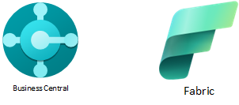
Conclusion and Key Takeaways
Transform Data Strategy
Effective use of Microsoft Fabric can revolutionize your data warehousing approach. Ease of configuring multiple data sources for cross source data mining and “mashup” reporting.
Integration Benefits
Combining Microsoft Fabric with Dynamics 365 enhances functionality and efficiency.
Optimize Data Management
Implementing best practices will lead to improved data management protocols and team collaboration. Cross functional groups will also become more self-sufficient.
Enhance Business Intelligence
Utilizing the right tools can significantly boost your business intelligence capabilities.
Notes:
In conclusion, leveraging Microsoft Fabric effectively can transform your data warehousing strategy, especially when integrated with Dynamics 365 Business Central. By applying best practices and utilizing the right tools, attendees can optimize their data management practices and enhance their business intelligence capabilities.

Slide 21

Q & A

